Slide 1
R Tidyverse
Olina Ngwenya, MSc
R Intermediate Course at UCT
Introduction to R Tidyverse
Nov 11-13, 2019
Acknowledgements: Dominic Henry (UCT Stats Dept)
Miles McBain (QUT)

Slide 2
Tidyverse
It’s not a package itself but a group of packages

Slide 3
Tidyverse
These packages can work together because they share:
Underlying design philosophy
Share consistent grammar
Share common data structures and representations
Developed by Hadley Wickham (Main Contributor)

Slide 4
Tidyverse continued…

Slide 5
Workflow

Slide 6
Importing data
Replaces the full stop, read_csv instead of read.csv
Behaviour of read_csv
Discards row names
Ability to detect dates and times
Characters remain characters
Fast
Creates a tibble object

Slide 7
Tibble continued..

Slide 8
Data structure of tidy data
Each row is an observation
Each column is a variable
Each cell is a value
Example of tidy data

Slide 9
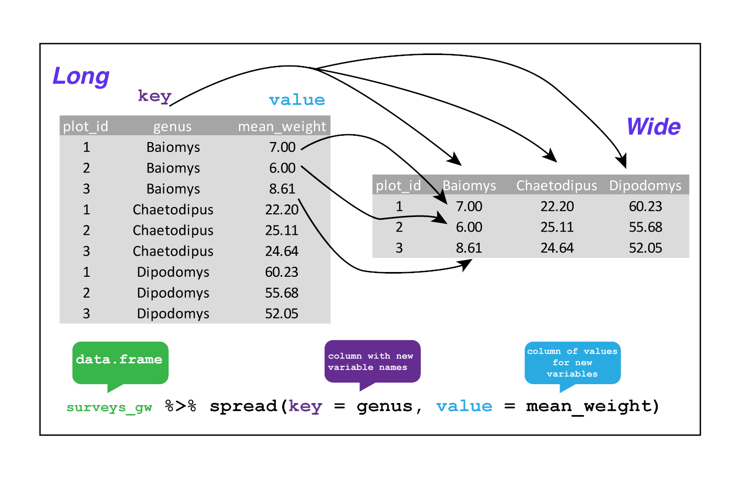

Slide 10
Data Wrangling
The art of getting your data into R in a useful form for visualisation and modelling.

Slide 11
Data wrangling continued…

Slide 12
Data wrangling typical tasks
Explore structure
Validate observations
Create variables
Select observations
Prepare input for models and visualisations

Slide 13
The pipe operator
data %>% f1() %>% f2() %>% f3()
This means apply f1 to your data then apply f2 to the output found after f1 was applied and so on.
Can also be written as
f3(f2(f1(data))).

Slide 14
Dplyr verbs
select(): choose variables (cols) by name

Slide 15
Dplyr verbs continued…
filter(): filter observations (rows) based on their value

Slide 16
Dplyr verbs continued….
mutate(): create new variables from existing ones

Slide 17
Dplyr verbs continued…
arrange(): change the order of observations

Slide 18
Dplyr verbs continued…
group by(): select a factor by which to group observations

Slide 19
Dplyr verbs continued…
summarise(): reduce observations into single value.

Slide 20
Dplyr verbs continued…
* join(): combine data frames (*left, right, inner, full)

Slide 21
Dplyr + pipe
Option 1
data1 <- select(data, ...)
data2 <- filter(data1, ...)
data3 <- mutate(data2, ...)
Option 2
data %>% select(...) %>% filter(...) %>% mutate(...)

Slide 22
Dplyr + pipe continued…
Advantages
Improved understanding - reads like a sentence
Remove unnecessary intermediate steps
Reduce creative effort (naming things sensibly is hard!)
Focus on the final desired output

Slide 23
Dates and times
dmy_hms()
Base R is confusing and frustrating
Quite simply, lubridate makes it easy to import and perform date time
operations!

Slide 24
Strings and regex
What do grep(), grepl(), regexpr(), gsub(), gregexpr() do?
How about str_detect(), str_count(), str_which(), str_locate(),
str_extract(), str_subset(), str_replace()?

Slide 25
Program
map(.x, .f, ...)
The core of purrr is a set of functions for manipulating vectors
Piping still a big part of the functionality
Alternative to apply() family of functions

Slide 26
Factors
fct reorder()
Have you ever tried to change the factor order on a ggplot?
Many, many useful functions: http://forcats.tidyverse.org/reference/index.html

Slide 27
Visualize
Reduce number of objects by using dplyr + ggplot via pipe
Flexible in the preliminary data exploration stage
Compliment to summary tables
data %>% select() %>% filter() %>%
group by() %>% summarise() %>%
ggplot(aes(x, y,fill)) +
geom bar()

Slide 28
Resources

